Slide 1
Research Methods Week 1

Slide 2

Course Structure
A weekly 1 hour lecture
A weekly 2 hour seminar
2 assessments
Group Presentation (20%)
Research Proposal (80%)

Slide 3
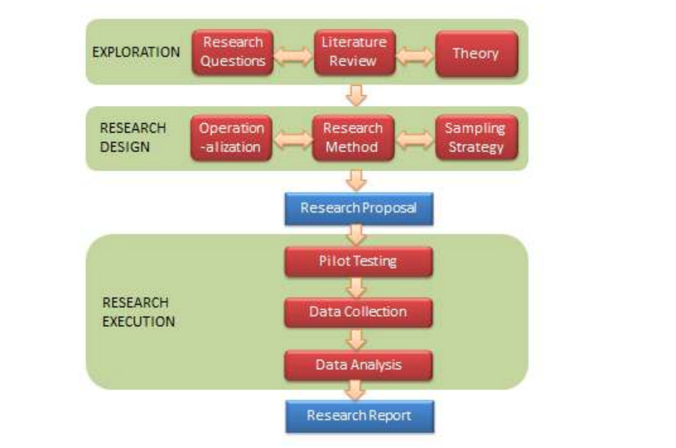
Assessment 1 (1)
From Groups
t
Pick a Divisive Topic
Record a 5/10 min Discussion/Presentation

Slide 4
Assessment 2 (Project Proposal)
Due: 10th Jan, 2020
Problem Statement
Hypothesis/ Research Question
Literature Review
Exploration
t
Research Methods
Research Schedule
Specification
Final Year

Slide 5
Module Block
Introducing Research
Reading and Referencing
Writing and Communication
Conducting Rersearch

Slide 6


Slide 7
Week 1
1. What assessments do I need to complete?
2. What does it mean to be a graduate?
3. What is research?
4. What is reality, and how might I access this reality when conducting my research?

Slide 8
What does it mean to be a graduate?

Slide 9
"Graduates are thought to feel a need to seek and evaluate evidence before coming to a conclusion, not to accept ‘spin’ as readily as non-graduates, to question the status quo to show intellectual curiosity about the social world**"
>> Biggs 2011, p.111
"Laziness and cowardice are the reasons why such a large part of mankind gladly remain [immature] all their lives, long after nature has freed them from external guidance [...]. It is so comfortable to be a [immature]. If I have a book that thinks for me, a pastor who acts as my conscience, a physician who prescribes my diet, and so on--then I have no need to exert myself. I have no need to think.”
>> Kant 1784, p.1

Slide 10
What Is Research?

Slide 11
Research is generating new knowledge through scientific method
It must be
- Reliable
- Repeatable
- Valid

Slide 12
The Overall Journy
Problem Statement
Hypothesis/ Research Question
Literature Review
Exploration
Artifacts
Research Methods
Research Schedule
Plan
Implement artifact
Implementation
Collect Data
Answer Research Question/Hypothesis
Conclude your Work
Evaluate

Slide 13
What is Reality?

Slide 14
You will need to access your version of reality to evaluate final year project

Slide 15
Qualitative vs Quantitative

